Slide 1
Intelligent Chatbot Script Editor
GAPT Presentation – Nathan Bonavia Zammit, Benjamin joseph Spiteri, Anthony ‘toni’ mifsud

Slide 2
Goals
A functional prototype which performs the following:
Accepts custom scripts from the user
Generates a GUI based off said script
Functionality to rectify images off of google

Slide 3
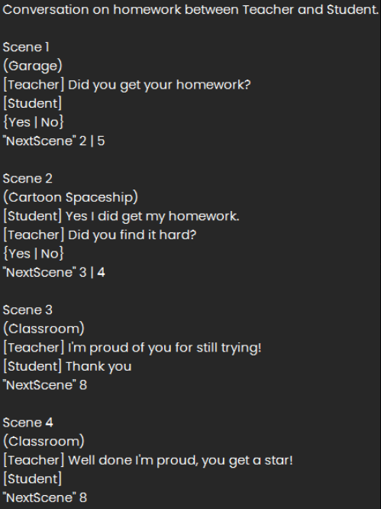
Custom Scripts
Parsing of the scripts was performed as follows:
Recognition of custom patterns for:
Backgrounds
Choices
Characters
Dialogues
Scenes

Slide 4
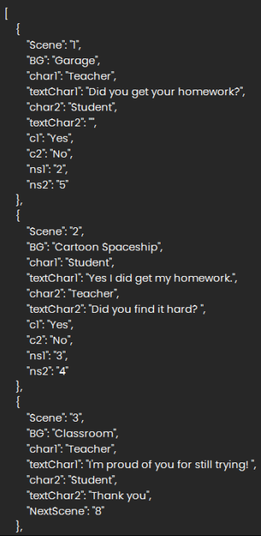
Output of Parsing Section
Data used is as follows:
A list of dictionaries

Slide 5
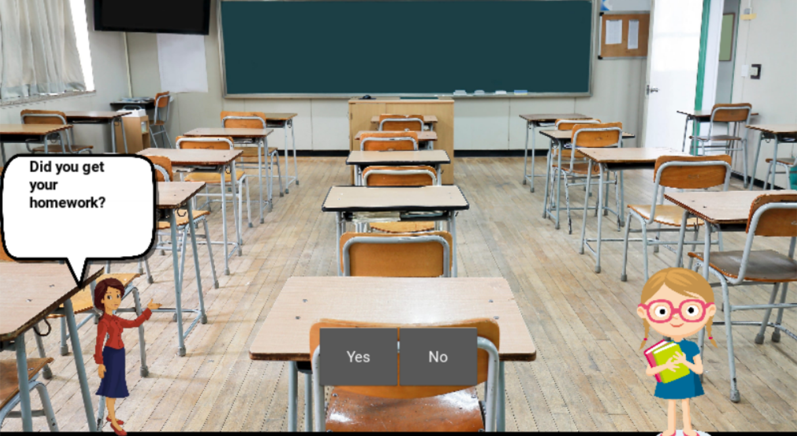
GUI
KIVY was used
Multiplatform app development framework
Very practical to use
Automatic Image Searching - Google API

Slide 6

Demo
For our presentation we will now move on to a live Demo.

Slide 7
Thank you for listening

